Slide 1
Software Construction
Software Configuration Management

Slide 2
Introduction
It is an umbrella activity that is applied throughout the software process. Because changes can occur at any time, SCM activities are developed to
identify change
control change
ensure that change is being properly implemented
report change to others who may have an interest
The primary responsibility is the control of change

Slide 3
SCM Vs. Software maintenance
Maintenance is a set of SE activities that occur after software has been delivered to the customer and put into operation
SCM is a set of tracking and control activities that begin when a software project begins and terminate only when the software is taken out of operation

Slide 4
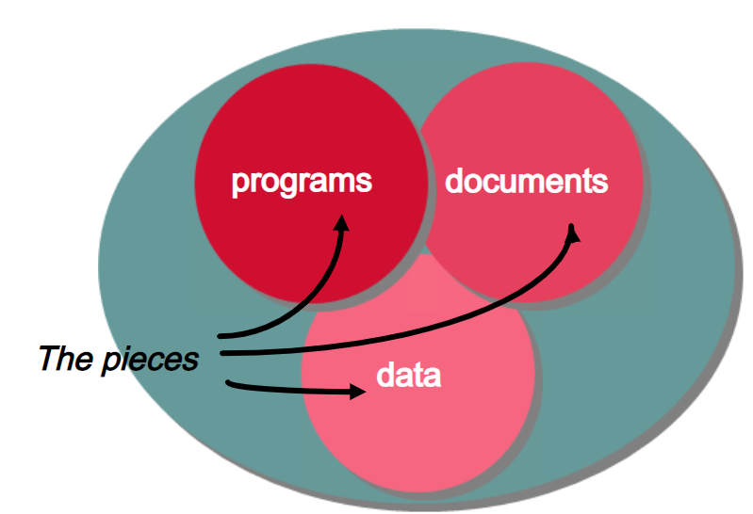
What is Software Configuration?
Items (such as programs, documents and data) that consist of of all information produced as part of the S/W process are collectively called a Software Configuration
As the software process progresses, the number of software configuration items (SCIs) grows rapidly

Slide 5
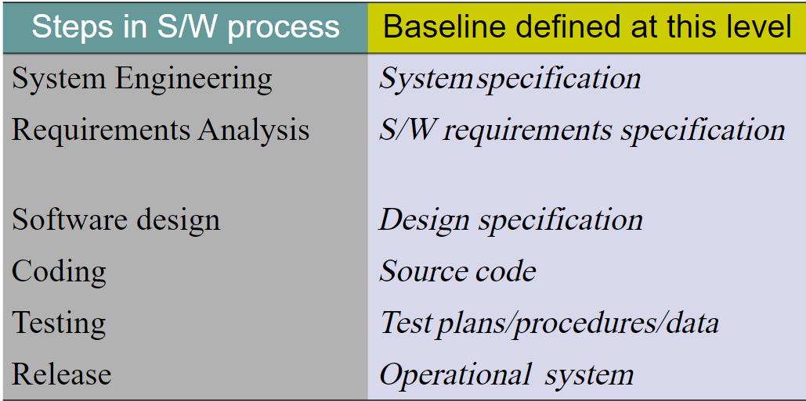
Cont…

Slide 6
What is a configuration item?
An SCI is an collection of software that is designated for configuration management and treated as a single entity in the SCM process
An SCI is a document ,an entire suite of test cases , or a named program component.
Plans, Specification and design documentation
Testing materials
Software tools
Source and executable code and Code libraries
Data and data dictionaries
Documentation for installation, maintenance, operations and software use

Slide 7
The SCM process
How does an organization identify and manage the many existing versions of a program in a manner that will enable change to be accommodated efficiently?
How does an organization control changes before and after software is released to a customer?
Who has responsibility for approving and prioritizing changes?
How can we assure that changes have been made properly?
What mechanism is used to appraise others of changes that are made?…
These questions lead to the definition of 5 SCM tasks.

Slide 8
5 SCM tasks
Identification
Change Control
Version Control
System Build
Release Management

Slide 9
Change Control
Change Control
Submitted and evaluated to assess technical merit and impact on the other configuration objects and budget
Change report
contains the results of the evaluation
Change control authority (CCA)
makes the final decision on the status and priority of the change based on the change report

Slide 10
Change Control
Engineering change order (ECO)
generated for each change approved (describes change, lists the constraints, and criteria for review and audit)
Modified object is checked-in to the project database and version control mechanisms are used to create the next version of the software
Synchronization control
used to ensure that parallel changes made by different people don’t overwrite one another
Modified object is subjected to appropriate SQA and testing procedures

Slide 11
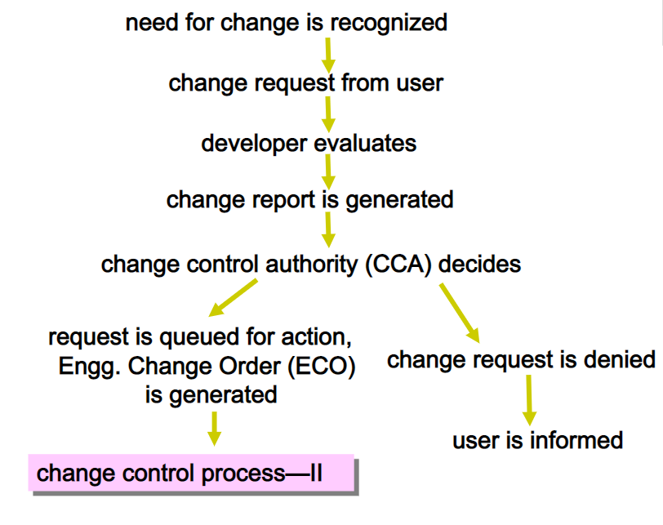
Change Control Process—I

Slide 12
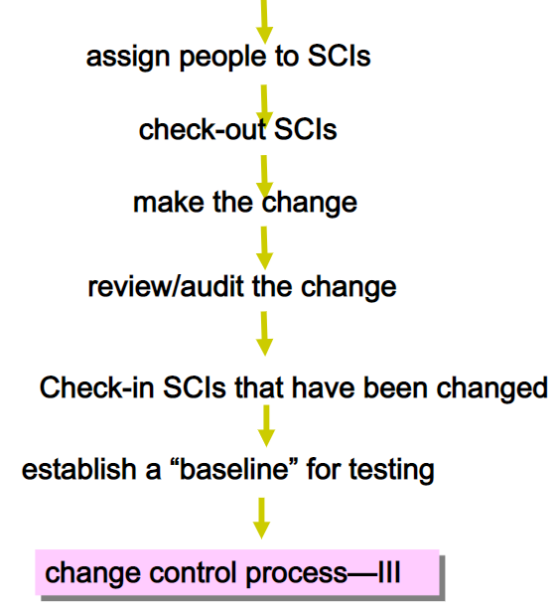
Change Control Process-II

Slide 13
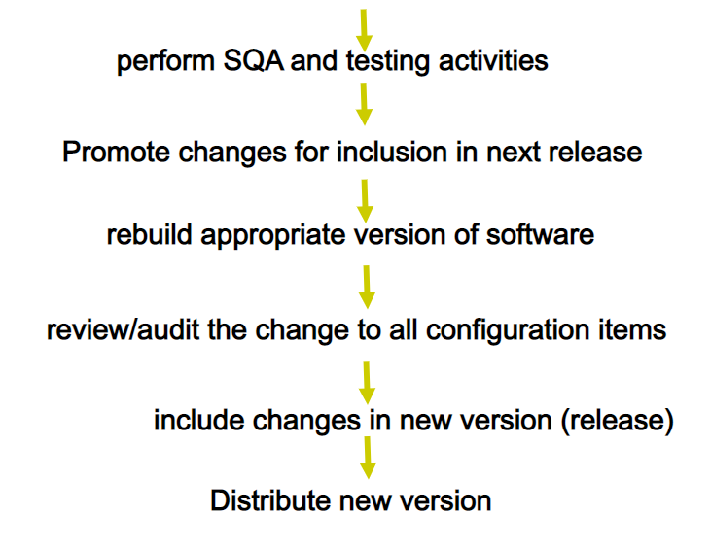
Change Control Process-III

Slide 14
Version Control
Combines procedures and tools to manage the different versions of configuration objects created during the software process
It keep track of the version numbers of the software system it name is already defining it.

Slide 15
System Build
In a software system the System Build links the source code components together into a Build version that can be tested by the development team.
For a hardware solution, the individual components will be assembled and tested as a complete system.
It is a complex process, this phase also communicate with the version control system to check the previous build and to decide what should be the next build.
Sometimes developers build a system just for there testing process before giving it to the client, it is important to keep track of that system is well.
It also keep check and balance of time stamp.

Slide 16
Release Management
Release management keep track of the releases of the software to customers.
It also keep track of the all other kind of releases.
There are two kind of release major release and minor release.
Like if the release number or let say version number is 8.4.1 it means minor release number is 1 and major release is 4 and the main software is 8.

Slide 17
Capability Maturity Model (CMM)
The Capability Maturity Model (CMM) is a framework used to assess and improve an organization's processes. It was initially developed by the Software Engineering Institute (SEI) at Carnegie Mellon University and has since been applied across various industries beyond software development.
CMM focuses on evaluating and enhancing the maturity of an organization's processes in specific areas, enabling them to gradually evolve and improve their overall performance, quality, and efficiency.
The SEI Process Capability Maturity Model (“CMM”)
CMM defines a five-level scale of process maturity, and an organization’s software process is assessed as “CMM-1”, “CMM-3”, “CMM-5” indicating its level on the scale
Used by government agencies and companies in the U.S.
Assessed using an 85-item questionnaire
ftp://ftp.sei.cmu.edu/pub/education/93em008.pdf

Slide 18
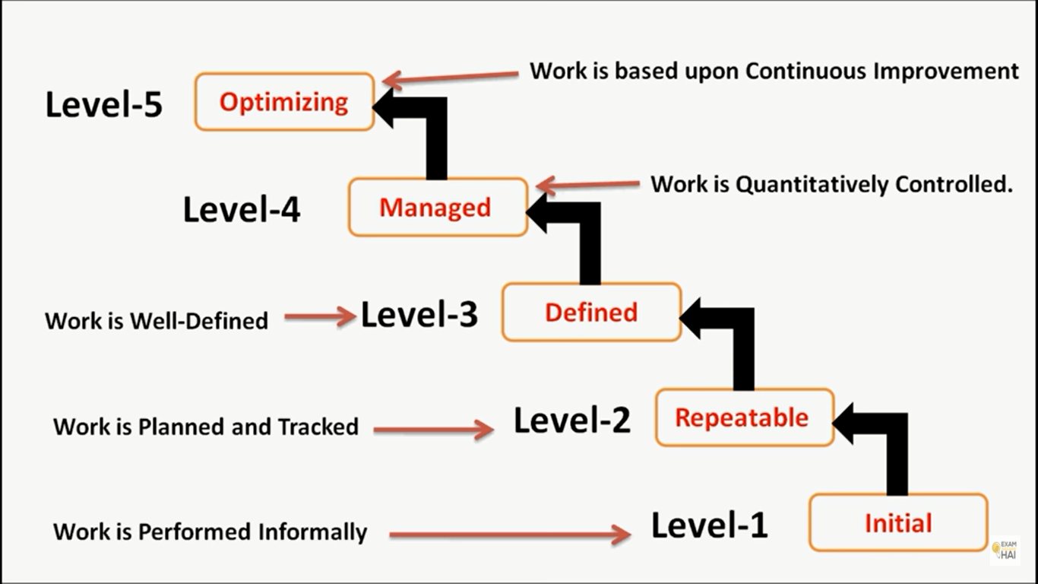

Slide 19
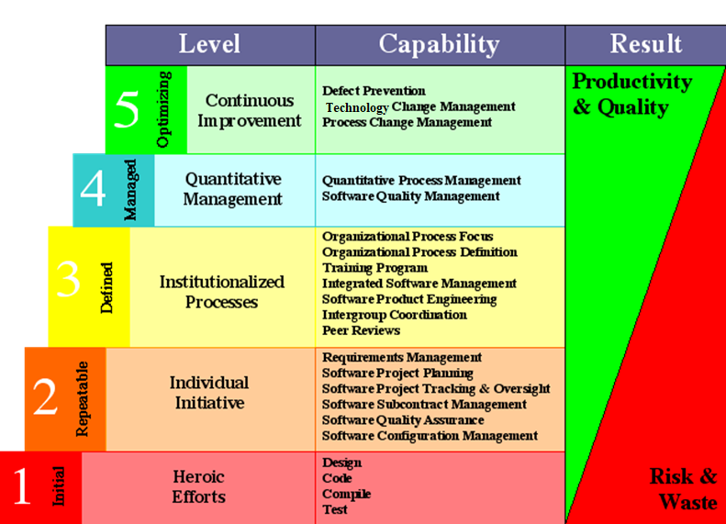
Capability Maturity Model (CMM)
Notes:
3. Institutionalized Processes: Organizational Process Definition. This process involves determining what work is needed to accomplish the goal, assigning those tasks to individuals, and arranging those individuals in a decision‐making framework (organizational structure). The purpose of Organizational Process Focus (OPF) (CMMI-DEV) is to plan, implement, and deploy organizational process improvements based on a thorough understanding of current strengths and weaknesses of the organization's processes and process assets. The training program is defined as an activity or activities that include undertaking one or a series of courses to boost performance, productivity, skills, and knowledge. It is generally a cost-budget endeavor with flexible time. Windchill Integrations for Embedded Software provides a centralized product life management platform that allows companies to develop and manage both hardware and software product components using integrated product configuration, life cycle management, and change management processes.
Windchill Integrations for Embedded Software provides seamless access to software artifacts, such as software executables, source code, and software defects, that are typically contained in remote systems specialized for software development. Product Engineering is the process of innovating, designing, developing, testing and deploying a software product. Intergroup Coordination involves the software engineering group's participation with other project engineering groups to address system-level requirements, objectives, and issues. Representatives of the project's engineering groups participate in establishing the system-level requirements, objectives, and plans by working with the customer and end users, as appropriate. These requirements, objectives, and plans become the basis for all engineering activities. A peer-reviewed publication is also sometimes referred to as a scholarly publication. The peer-review process subjects an author's scholarly work, research, or ideas to the scrutiny of others who are experts in the same field (peers) and is considered necessary to ensure academic scientific quality.
4. Quantitative Management The purpose of Quantitative Project Management (QPM) (CMMI-DEV) is to quantitatively manage the project to achieve the project's established quality and process performance objectives. Software quality management (SQM) is a management process that aims to develop and manage the quality of software in such a way so as to best ensure that the product meets the quality standards expected by the customer while also meeting any necessary regulatory and developer requirements, if any. 5. Continuous Improvement: Defect Prevention (DP) is a strategy applied to the software development life cycle that identifies root causes of defects and prevents them from recurring. It is the essence of Total Quality Management (TQM). Technology Change Management involves identifying, selecting, and evaluating new technologies, and incorporating effective technologies into the organization. The objective is to improve software quality, increase productivity, and decrease the cycle time for product development. The change request management process in systems engineering is the process of requesting, determining attainability, planning, implementing, and evaluating of changes to a system. Its main goals are to support the processing and traceability of changes to an interconnected set of factors.

Slide 20
Capability Maturity Model (CMM)
(1) CMM Level 1 - “Initial”
A software development organization at this level is characterized by ad hoc activities. Very few or no processes are defined and followed. Since software production processes are not defined, different engineers follow their own process and as a result development efforts become chaotic. Therefore, it is also called chaotic level. The success is only due to some individuals, and when they leave the organization, the people left behind feel great difficulty to understand what has been done and what is to be done due to lack of processes. This leads to low quality.
(2) CMM Level 2 - “Repeatable”
At this level, the basic project management practices such as tracking cost and schedule are established. cost estimation techniques like function point analysis, COCOMO, etc. are used. The necessary process discipline is in place to repeat earlier success on projects with similar applications. Hence, the existing process is repeated, it is helpful only if we are working on same kind of problems.
(3) CMM Level 3 - “Defined”
At this level the processes for both management and development activities are defined and documented. There is a common organization-wide understanding of activities, roles, and responsibilities. The processes though defined, the process and product qualities are not measured. ISO 9000 aims at achieving this level.

Slide 21
Capability Maturity Model (CMM)
(4) CMM Level 4 - “Managed”
At this level, the focus is on software metrics. Two types of metrics are collected. Product metrics (measures size, reliability, time complexity, understandability)Process metrics (measures average defect correction time, productivity, average number of defects found per hour inspection)Quantitative quality goals are set for the products. The process metrics are used to check if a project performed satisfactorily. Thus, the results of process measurements are used to evaluate project performance rather than improve the process.
(5) CMM Level 5 - “Optimizing”
At this stage, process and product metrics are collected. For example, if from an analysis of the process measurement results, it was found that the code reviews were not very effective and a large number of errors were detected only during the unit testing, then the process may be fine tuned to make the review more effective. Also lessons learned from specific projects are incorporated into the process. Continuous process improvement is achieved both by analyzing the quantitative feedback from the process measurements and from application of innovative ideas and technologies. Such an organization identifies the best software engineering practices and innovations which may be tools, methods, or processes.

